Slide 1
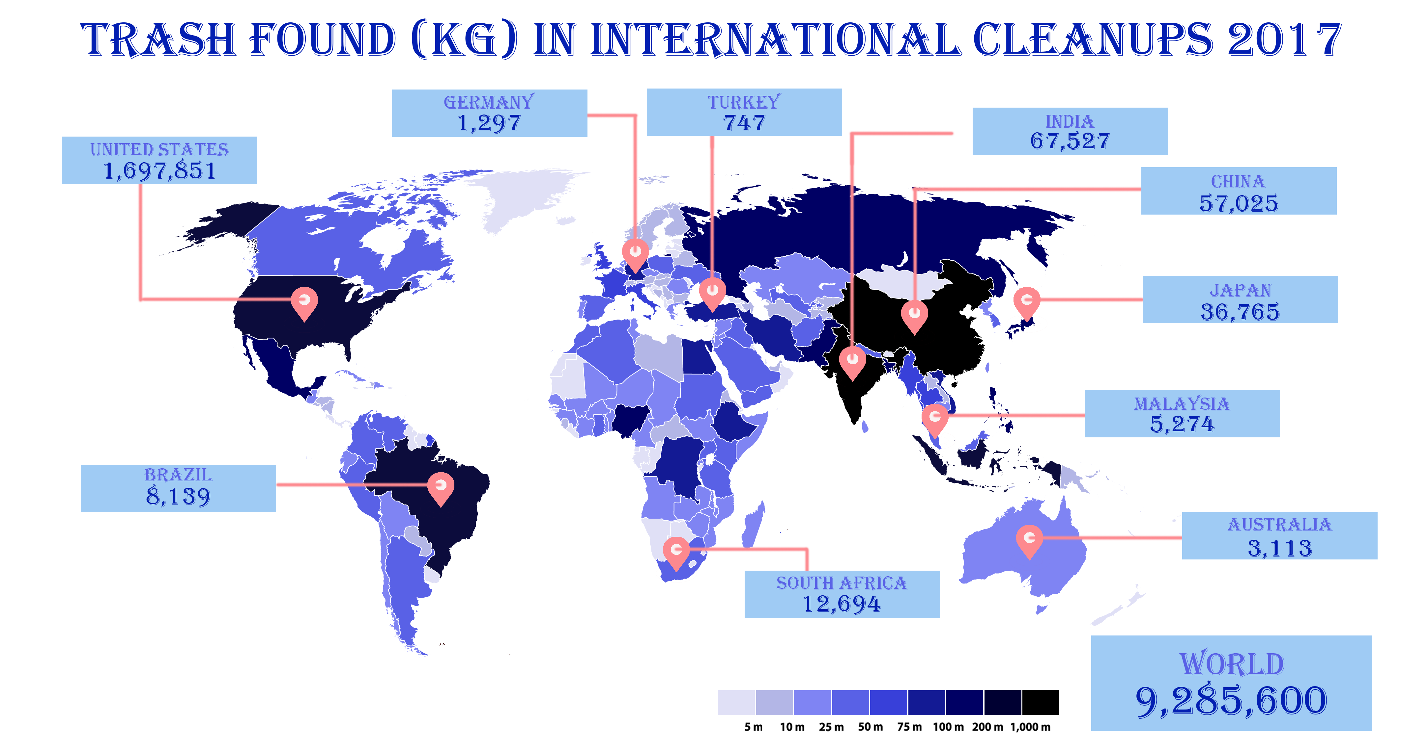
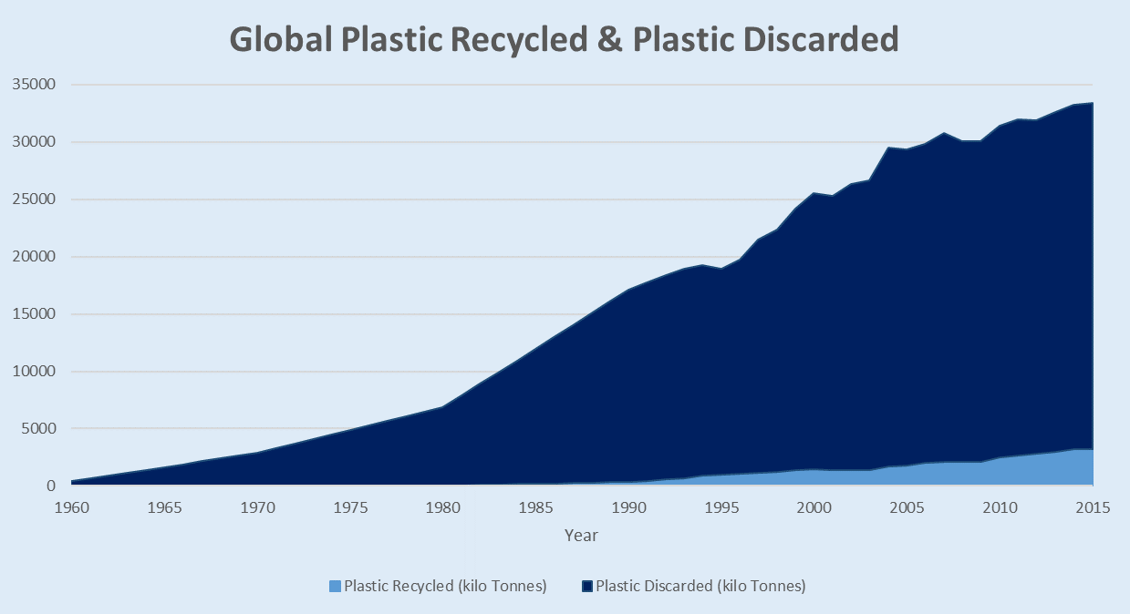
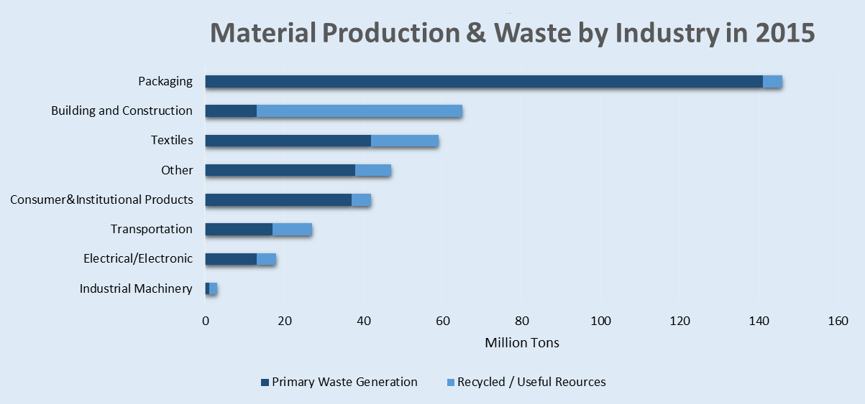
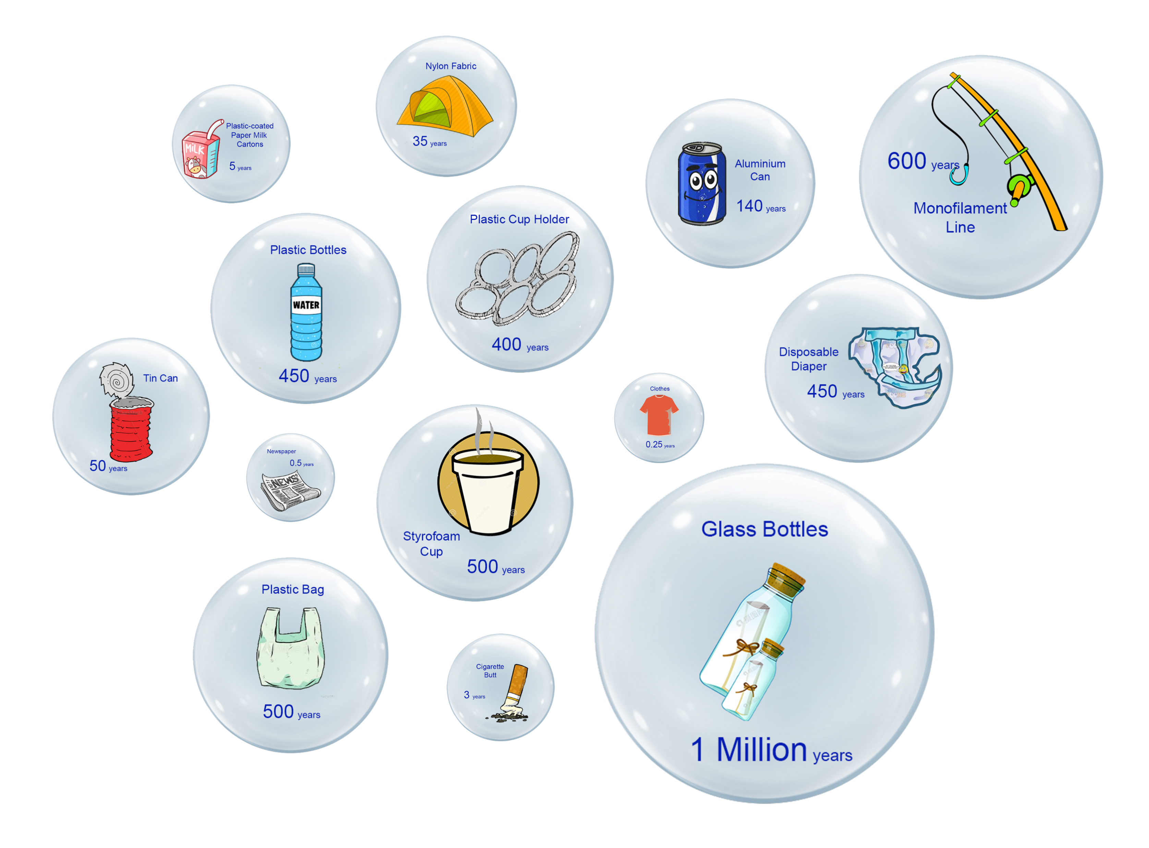

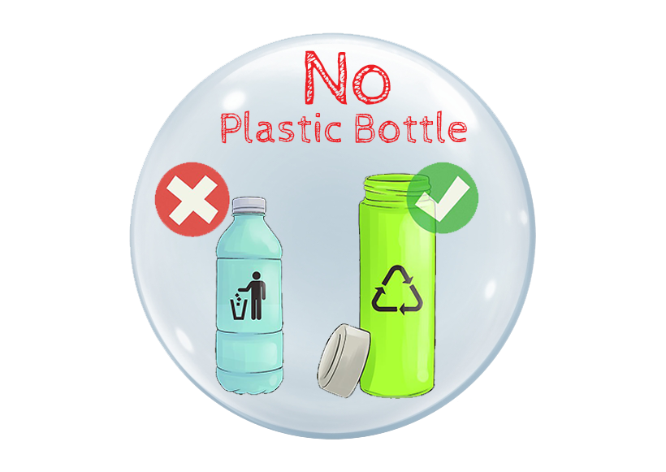

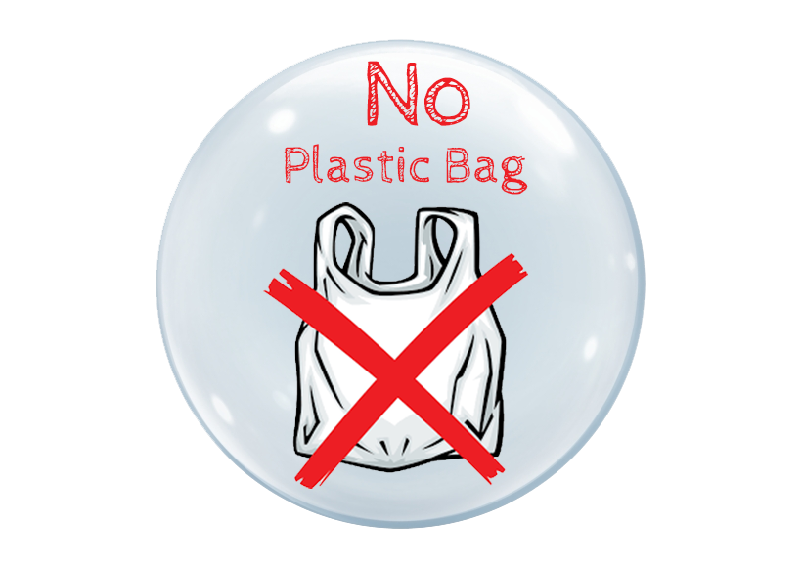

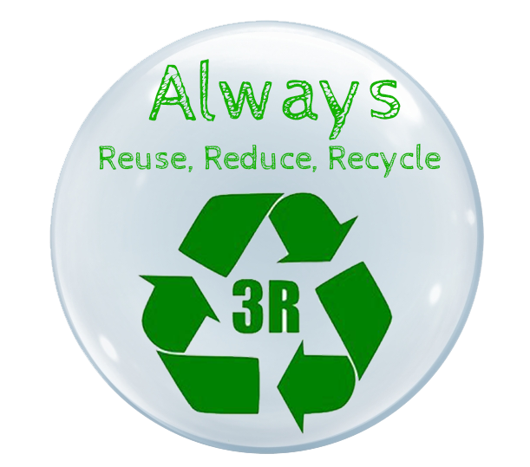
What Do You Know About
Plastic Pollution?
Population:
90%
{
Waste
How long does it last?
How can we help reduce
Plastic Waste?
Sources:
1. https://oceanconservancy.org/wp-content/uploads/2018/07/Building-A-Clean-Swell.pdf
2. https://advances.sciencemag.org/content/advances/suppl/2017/07/17/3.7.e1700782.DC1/1700782_SM.pdf
3. https://www.epa.gov/facts-and-figures-about-materials-waste-and-recycling/advancing-sustainable-materials-management
4. http://www.nrpa.com/our-environment/decomposition-rates-for-common-types-of-marine-debris/

